Slide 1

Executive Summary Of Airline Safety Analysis
Insights and Strategic Recommendations
04/21/2024
Kalyan Pothineni
DSC640

Slide 2
Content
Introduction
Trends in Accidents and Fatalities
Comparative Safety Performance
Seasonal Trends in Accidents
Geographical Distribution of Incidents
Common Causes of Crashes
Conclusion and Strategic Recommendations
Q&A

Slide 3
Introduction
Purpose of Analysis:
Utilize comprehensive safety data to drive strategic decisions, enhance safety protocols, and bolster regulatory compliance.
Strategic Objectives:
Risk Management: Identify and mitigate safety risks to enhance operational reliability.
Regulatory Leadership: Exceed safety standards to lead the industry and build stakeholder trust.
Operational Improvement: Translate safety insights into actionable improvements that boost customer satisfaction and operational efficiency.
Visualization:
An infographic that links safety data analysis with key business outcomes:
Data Insights → Strategic Actions → Enhanced Safety & Compliance → Improved Business Performance
Key Takeaway:
“Empowering strategic decisions with data-driven insights to achieve excellence in airline safety and operations.”

Slide 4
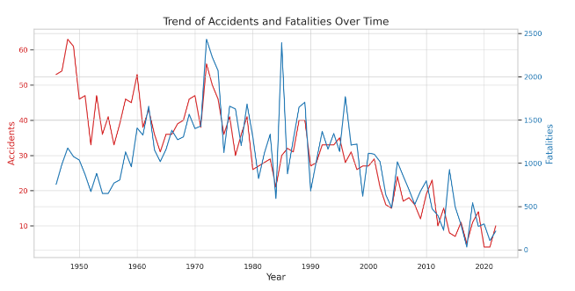
Trends in Accidents and Fatalities
The line graph illustrates the annual trend of total accidents (red) and fatalities (blue) over time. This visualization helps identify periods of increased accidents or improvements in safety, which are critical for assessing the effectiveness of safety measures implemented over the years.

Slide 5
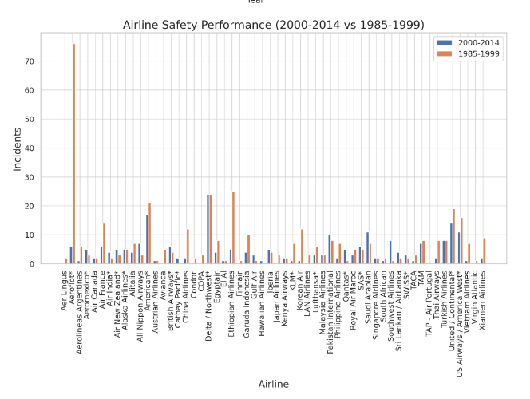
Comparative Safety Performance
The bar chart compares the number of incidents for each airline across two different periods. This allows us to see which airlines have improved or worsened in terms of safety, providing a perspective on the airline's performance relative to the industry.

Slide 6
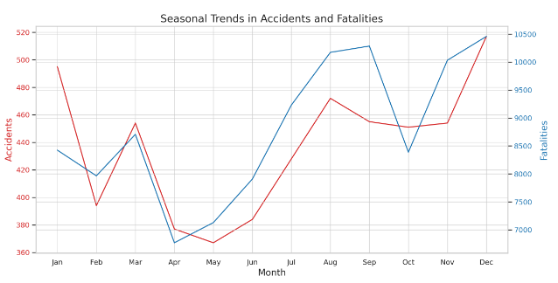
Seasonal Trends in Accidents
The red line shows the number of accidents each month, while the blue line represents the number of fatalities. You can observe any seasonal peaks or trends in this visualization, which may indicate times of the year when accidents are more frequent and potentially more severe.

Slide 7
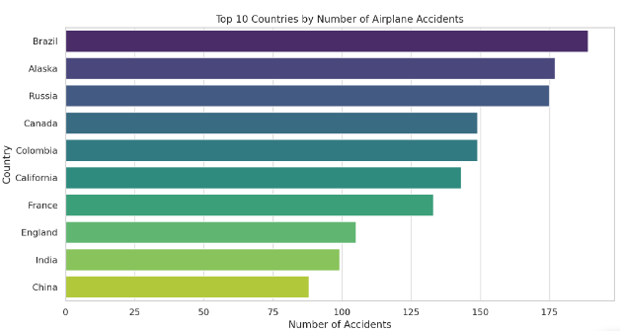
Geographical Distribution of Accidents
Car chart of the top 10 countries by number of airplane accidents. Analysis of high-risk geographical areas

Slide 8
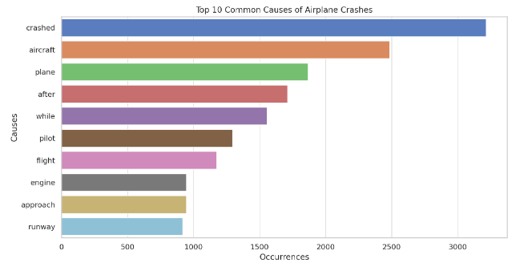
Common Causes of Crashes
This visualization lists the most frequently mentioned keywords in the summaries of crash reports, which can give insights into common factors or conditions associated with airplane crashes

Slide 9
Key Findings
Safety Trends: Historical data analysis reveals a general trend of improving safety, with periodic spikes in accidents highlighting areas for targeted improvements.
Comparative Performance: Our airline's safety performance, when benchmarked against the industry, shows areas of strength as well as opportunities for enhancement to align with the best practices.
Seasonal and Geographical Risks: Certain times of the year and specific regions exhibit higher risks, necessitating focused safety measures during these periods and in these areas.
Common Causes of Accidents: Analysis of crash causes has identified key factors that contribute to accidents, guiding our priorities for safety interventions.

Slide 10
Strategic Recommendations
Enhanced Monitoring During High-Risk Periods
Targeted Safety Measures in High-Risk Regions
Focus on Human Factors and Maintenance
Stakeholder Communication Strategy:
Transparency with Data
Engagement with Regulatory Bodie
Continuous Improvement
Data Analysis → Identified Risks → Strategic Actions → Improved Safety Outcomes

Slide 11
Thank you
We welcome your questions and feedback

